Slide 1
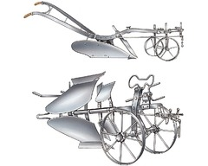
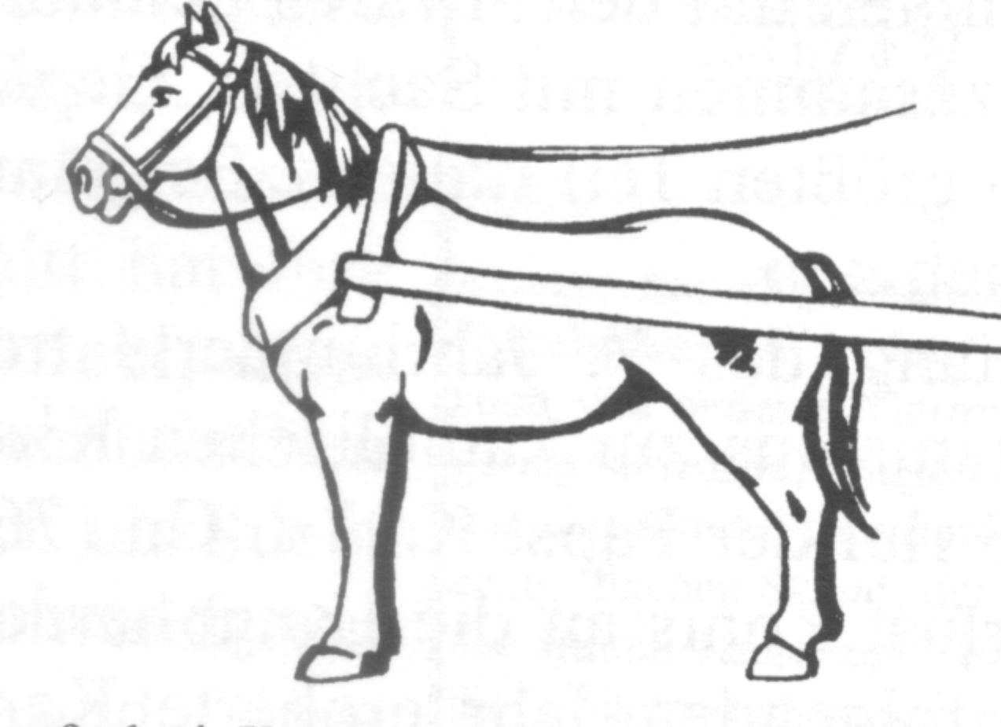
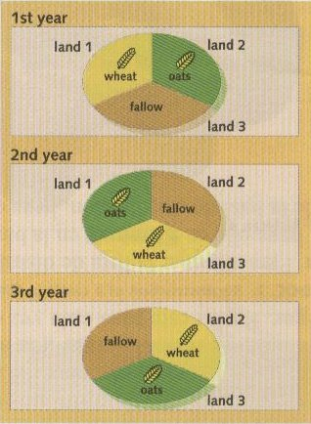
Economic Recovery Sparks Change
Agricultural Revolution:
New Technology: Iron plows and improved harnesses
Rotation of Crops: Richer soil and more land being used
More food production equals population growth / tripled between 1100 and 1300

Slide 2
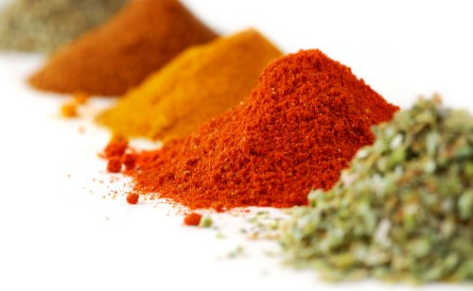
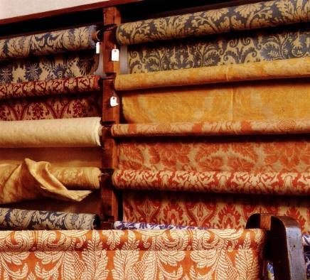
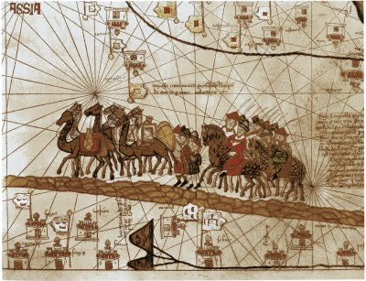
The Revival of Trade and Travel:
1100s feudal warfare declined / people felt safer
Crusaders brought luxury goods back from East
Traders traveled all over Europe to obtain goods for wealthy nobles and farmers
Trade Routes Expand:
Goods came from Asia, Middle East, Constantinople
Silk, gold, spices, honey, furs, cloth, tin, and lead.

Slide 3
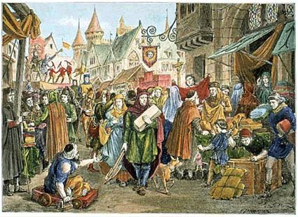
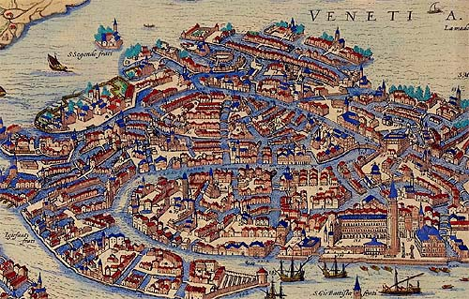
The Growth of Towns and Cities:
Trade fairs became settlements which eventually became cities
Early cities might have 10,000 people.
By the 1300s some had over 100,000 people.
As manors became overcrowded some lords let peasants buy their freedom and move into towns.

Slide 4
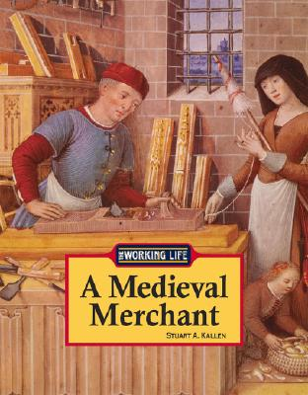
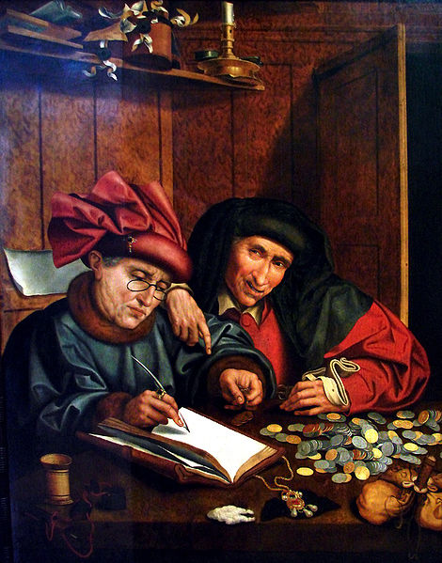
A Commercial Revolution:
The use of money (capital) increased
Banking houses opened
Merchants offered credit
Many traders used credit instead of cash (deposit, like a bank) – they did not have to carry gold with them

Slide 5
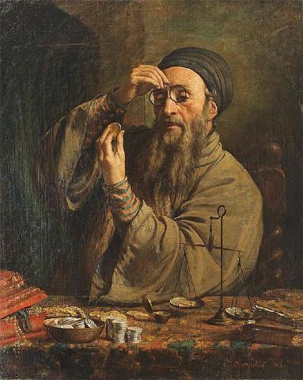
A Commercial Revolution:
The Christian church forbade lending of money with interest (called usury) –
Jews became money lenders –
Their success caused resentment and prejudice

Slide 6
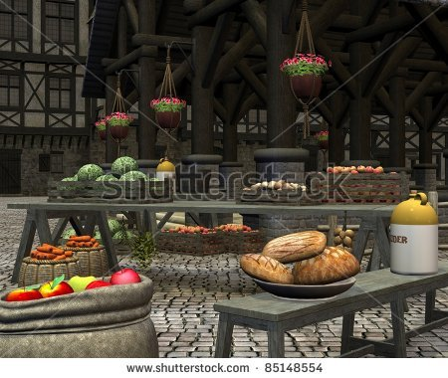
Society Begins to Change:
New business and the use of money undermined feudalism
Feudal lords needed money to buy goods
Peasants began selling produce and paid cash rent to their lord rather than in labor
By 1300 most peasants were tenant farmers

Slide 7
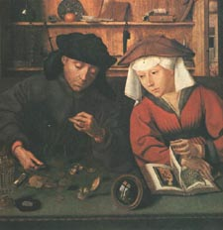
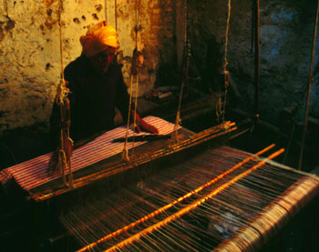
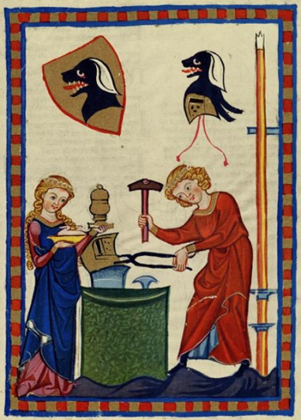
The Rise of the Middle Class:
By 1000 A.D. merchants, traders and artisans formed a new social class called the Middle Class
The Middle Class gained economic and political power
They formed associations called guilds.
Guilds represented merchants in one occupation - weaver, bankers, goldsmiths
They made rules to protect quality of goods: hours of labor, set prices, offered services to help members

Slide 8
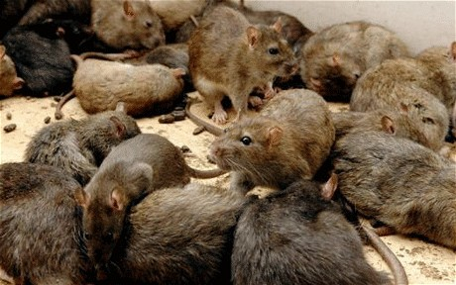
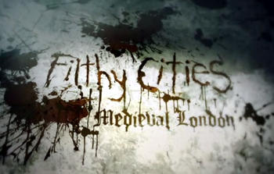
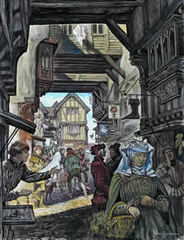
Medieval City Life:
Medieval towns were surrounded by high city walls
Most cities were overcrowded
Fire was a constant threat
Larger cities had tall cathedrals
People of similar backgrounds and or guilds lived in the same areas
No garbage collection or sewers
Towns were filthy, smelly, noisy and crowded
Disease was common

Slide 9
